Slide 1


Varun Arya
8/12/2024

Slide 2

Outline
Executive Summary
Introduction
Methodology
Results
Conclusion
Appendix

Slide 3
Executive Summary
Summary of methodologies
Summary of all results
All of the code written works perfectly well
All of the steps mentioned in the summary of methodologies were executed successfully in code
Data Collection
Web scraping
Data Wrangling
EDA
Machine Learning Prediction

Slide 4
Introduction
Project Background and Context
1. SpaceX's Reusability Goal: SpaceX aims to reduce the cost of space travel by reusing the first stage of the Falcon 9 rocket, which is designed to return and land after launch.
2. Cost Efficiency: A successful landing of the first stage is crucial in saving millions of dollars per launch, making space missions more affordable and competitive.
3. Competitive Edge: SpaceX’s ability to reliably land and reuse rocket stages gives it a significant advantage over other space agencies and private companies, which typically use expendable rockets.
4. Technological Advancement: Predicting the likelihood of a successful landing can help improve the algorithms and technology involved in rocket recovery, contributing to advancements in aerospace technology.
5. Environmental Impact: Reusing rocket stages reduces the environmental footprint of space missions by minimizing the need for new materials and reducing space debris.
Problems You Want to Find Answers To
1. Landing Prediction: Can we accurately predict the likelihood of the Falcon 9’s first stage landing successfully based on historical launch data?
2. Influence of Payload: How does the payload mass and orbit destination affect the success rate of the first stage landing?
3. Impact of Launch Sites: Do different launch sites affect the probability of a successful landing? Which sites have the highest success rates?
4. Effect of Rocket Configuration: How do variations in rocket configuration, such as the use of grid fins or the type of landing pad, influence landing outcomes?
5. Improving Success Rates: What factors can be adjusted or optimized to improve the likelihood of successful landings in future missions?

Slide 5

Section 1

Slide 6
Methodology
Executive Summary
Data Collection Methodology
Utilized SpaceX's REST API to gather historical launch data, including details on rocket launches, payloads, launch sites, and landing outcomes. Extracted and parsed data from the API into a structured format suitable for analysis, focusing on key attributes relevant to the Falcon 9 first stage landings.
Perform Data Wrangling
Processed raw data by filtering, cleaning, and transforming it to handle missing values and inconsistencies. Normalized and structured the data to prepare it for analysis, ensuring it was in a format that could be used effectively for both exploratory and predictive analyses.

Slide 7
Perform Exploratory Data Analysis (EDA) Using Visualization and SQL:
Conducted exploratory analysis to uncover trends, patterns, and relationships within the data. Employed visualization techniques to better understand the data distribution, and SQL queries to extract insights from large datasets.
Perform Interactive Visual Analytics Using Folium and Plotly Dash:
Developed interactive visualizations to explore geographic data and landing outcomes, using tools like Folium for mapping and Plotly Dash for dashboard creation. Enabled users to interact with the data dynamically, facilitating deeper insights into the factors affecting landing success.
Perform Predictive Analysis Using Classification Models:
Built, tuned, and evaluated classification models to predict the success of Falcon 9 first stage landings. Applied machine learning techniques to identify the most significant predictors of landing success, with the goal of improving future landing outcomes.

Slide 8
Data Collection
Describe How Data Sets Were Collected:
Data was obtained using SpaceX's REST API via HTTP GET requests, specifically targeting the endpoint for past launches.
The JSON response from the API was parsed and normalized into a Pandas DataFrame, allowing for easier data manipulation and analysis.
Specific attributes such as booster versions, payload masses, and launch site details were extracted using custom auxiliary functions.
Present Your Data Collection Process Using Key Phrases:
Make API call to SpaceX `/v4/launches/past` endpoint and receive JSON response.
Parse and normalize the JSON response into a structured Pandas DataFrame.
Extract and compile specific launch details into a comprehensive dataset using custom helper functions.

Slide 9
Data Collection – SpaceX API
https://github.com/VAcodequest/Data-Science/blob/main/jupyter-labs-spacex-data-collection-api.ipynb
1. Start
2. Initiate API Request
Retrieve data using `requests.get()`.
3. Parse JSON Response
Convert JSON data into a DataFrame using `pd.json_normalize()`.
4. Extract Data Attributes
Define functions to extract key information (e.g., booster version, payload data).
5. Store Extracted Data
Save the extracted attributes into a dictionary.
6. Create Final DataFrame
Convert the dictionary into a Pandas DataFrame.
7. End

Slide 10
Data Collection Scraping
1. Start
2. Send HTTP Request
Use a library like `requests` to send a GET request to the target URL.
3. Receive Response
The server returns the HTML content of the webpage.
4. Parse HTML Content
Use a parser like `BeautifulSoup` to process the HTML data.
5. Extract Data
Identify and extract the required information (e.g., text, tables, images).
6. Store Data
Save the extracted data into a structured format like a CSV or DataFrame.
7. End
https://github.com/VAcodequest/Data-Science/blob/main/jupyter-labs-webscraping.ipynb

Slide 11
Data Wrangling
1. Start
2. Load Data
Import data from various sources (e.g., CSV, API).
3. Handle Missing Values
Identify and address missing data (e.g., filling, dropping).
4. Data Transformation
Convert data types, normalize, and scale features.
5. Feature Engineering
Create new features or modify existing ones.
6. Filter Data
Select relevant columns and filter rows as necessary.
7. Store Processed Data
Save the cleaned and processed data into a new file.
8. End
https://github.com/VAcodequest/Data-Science/blob/main/labs-jupyter-spacex-Data%20wrangling.ipynb

Slide 12
EDA with Data Visualization
https://github.com/VAcodequest/Data-Science/blob/main/edadataviz.ipynb
1. Histogram: Used to understand the distribution of individual variables, particularly for continuous data like payload mass or flight duration.
2. Box Plot: Employed to identify outliers and understand the spread and skewness of the data.
3. Scatter Plot: Used to explore relationships between two continuous variables, such as payload mass versus flight success.

Slide 13
EDA with SQL
https://github.com/VAcodequest/Data-Science/blob/main/jupyter-labs-eda-sql-coursera_sqllite.ipynb
Select Queries:
Retrieved specific columns and data from the database tables to analyze various metrics.
Join Queries:
Combined multiple tables based on related columns to create comprehensive datasets for analysis.
Aggregation Queries:
Used `GROUP BY`, `COUNT`, `SUM`, and `AVG` to summarize data, calculate totals, and find average values.

Slide 14
Build an Interactive Map with Folium
https://github.com/VAcodequest/Data-Science/blob/main/lab_jupyter_launch_site_location.ipynb
Markers: Added markers to indicate specific locations, such as launch sites or areas of interest, to provide a clear visual reference.
Explanation: Markers help users quickly identify and interact with key locations on the map, making it more engaging and informative.
Circles and Lines: Used circles to highlight regions around certain points and lines to connect related locations, representing flight paths or boundaries.
Explanation: Circles emphasize the area of influence or impact around a location, while lines visually depict relationships or movements between points, enhancing the map's narrative.
Polygons: Added polygons to demarcate larger areas, such as city boundaries or zones of interest, to provide context and visual grouping.
Explanation: Polygons offer a clear way to group related areas, helping users understand spatial relationships and the extent of different regions, thus providing better context for the data.

Slide 15
Build a Dashboard with Plotly Dash
Summary of Plots/Graphs and Interactions:
Pie Chart: To visualize the proportion of successful and failed launches for selected launch sites.
Range Slider and Scatter Plot: To filter payload mass ranges, which updates a scatter plot to show the correlation between payload mass and launch success.
Explanation of Why These Plots and Interactions Were Added:
Pie Chart: The pie chart provides an intuitive way to compare the success and failure rates of launches across different sites, offering insights into site performance.
Range Slider and Scatter Plot: The combination of a range slider and scatter plot enables users to explore how payload size impacts launch outcomes, with the ability to see results for specific payload ranges and site selections.
https://github.com/VAcodequest/Data-Science/blob/main/spacex_dash_app.py

Slide 16
Predictive Analysis (Classification)
Summarize how you built, evaluated, improved, and found the best performing classification model
You need present your model development process using key phrases and flowchart
https://github.com/VAcodequest/Data-Science/blob/main/SpaceX_Machine%20Learning%20Prediction_Part_5.ipynb

Slide 17
Results
Exploratory data analysis results
Interactive analytics demo in screenshots
Predictive analysis results

Slide 18

Section 2

Slide 19
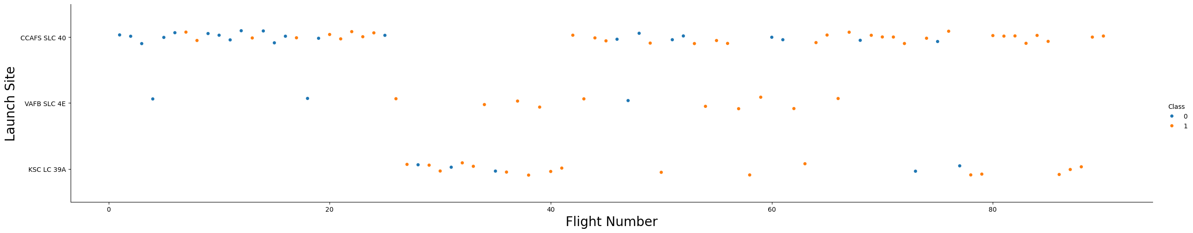
Flight Number vs. Launch Site
Show a scatter plot of Flight Number vs. Launch Site
Show the screenshot of the scatter plot with explanations

Slide 20
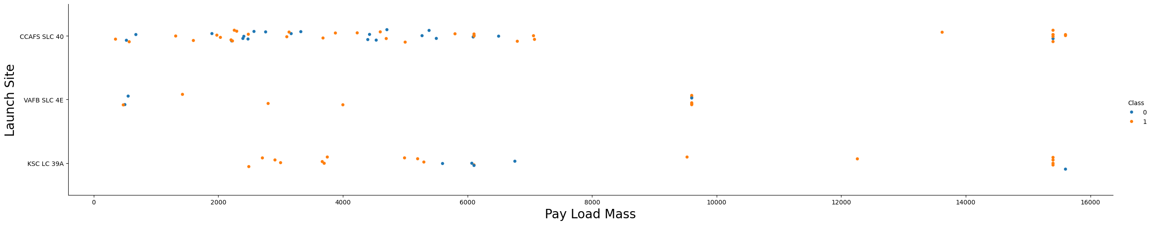
Payload vs. Launch Site
Show a scatter plot of Payload vs. Launch Site
Show the screenshot of the scatter plot with explanations

Slide 21
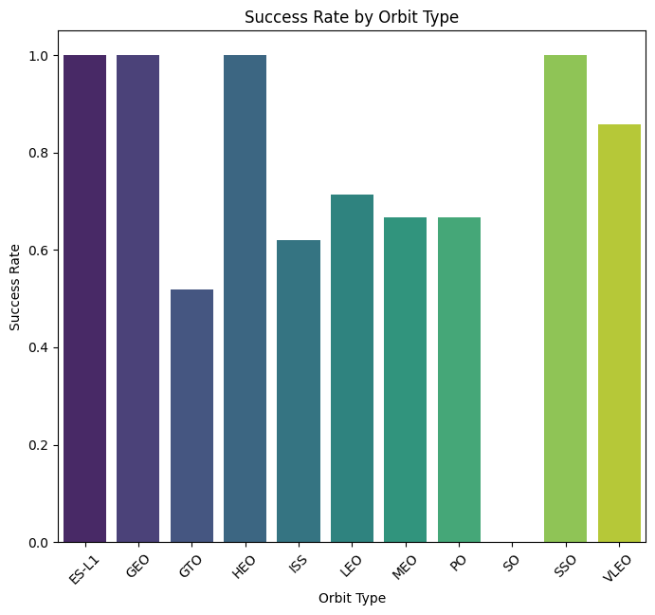
Success Rate vs. Orbit Type
Show a bar chart for the success rate of each orbit type
Show the screenshot of the scatter plot with explanations

Slide 22
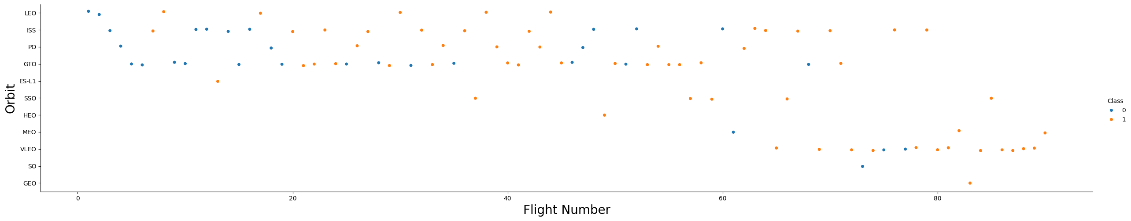
Flight Number vs. Orbit Type
Show a scatter point of Flight number vs. Orbit type
Show the screenshot of the scatter plot with explanations

Slide 23
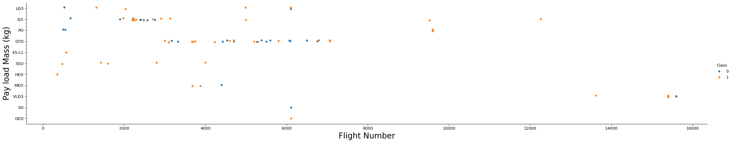
Payload vs. Orbit Type
Show a scatter point of payload vs. orbit type
Show the screenshot of the scatter plot with explanations

Slide 24
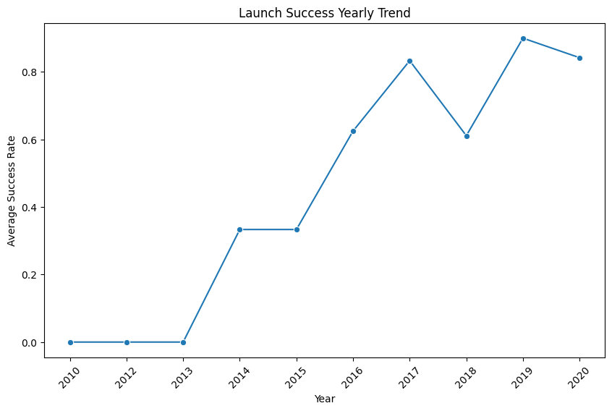
Launch Success Yearly Trend
Show a line chart of yearly average success rate
Show the screenshot of the scatter plot with explanations

Slide 25
All Launch Site Names
Find the names of the unique launch sites
Unique Launch Site Names: ['CCAFS SLC 40' 'VAFB SLC 4E' 'KSC LC 39A’]
This code will:
Extract the unique values from the 'Launch Site' column of the DataFrame spacex_df.
Print these unique values, which represent the different launch sites used.

Slide 26
Launch Site Names Begin with 'CCA'
Find 5 records where launch sites begin with `CCA`
Present your query result with a short explanation here

Slide 27
Total Payload Mass
Calculate the total payload carried by boosters from NASA
Present your query result with a short explanation here

Slide 28
Average Payload Mass by F9 v1.1
Calculate the average payload mass carried by booster version F9 v1.1
Present your query result with a short explanation here

Slide 29
First Successful Ground Landing Date
Find the dates of the first successful landing outcome on ground pad
Present your query result with a short explanation here

Slide 30
Successful Drone Ship Landing with Payload between 4000 and 6000
List the names of boosters which have successfully landed on drone ship and had payload mass greater than 4000 but less than 6000
Present your query result with a short explanation here

Slide 31
Total Number of Successful and Failure Mission Outcomes
Calculate the total number of successful and failure mission outcomes
Present your query result with a short explanation here

Slide 32
Boosters Carried Maximum Payload
List the names of the booster which have carried the maximum payload mass
Present your query result with a short explanation here

Slide 33
2015 Launch Records
List the failed landing_outcomes in drone ship, their booster versions, and launch site names for in year 2015
Present your query result with a short explanation here

Slide 34
Rank Landing Outcomes Between 2010-06-04 and 2017-03-20
Rank the count of landing outcomes (such as Failure (drone ship) or Success (ground pad)) between the date 2010-06-04 and 2017-03-20, in descending order
Present your query result with a short explanation here

Slide 35

Section 3

Slide 36
<Folium Map Screenshot 1>
Replace <Folium map screenshot 1> title with an appropriate title
Explore the generated folium map and make a proper screenshot to include all launch sites’ location markers on a global map
Explain the important elements and findings on the screenshot

Slide 37
<Folium Map Screenshot 2>
Replace <Folium map screenshot 2> title with an appropriate title
Explore the folium map and make a proper screenshot to show the color-labeled launch outcomes on the map
Explain the important elements and findings on the screenshot

Slide 38
<Folium Map Screenshot 3>
Replace <Folium map screenshot 3> title with an appropriate title
Explore the generated folium map and show the screenshot of a selected launch site to its proximities such as railway, highway, coastline, with distance calculated and displayed
Explain the important elements and findings on the screenshot

Slide 39

Section 4

Slide 40
<Dashboard Screenshot 1>
Replace <Dashboard screenshot 1> title with an appropriate title
Show the screenshot of launch success count for all sites, in a piechart
Explain the important elements and findings on the screenshot

Slide 41
<Dashboard Screenshot 2>
Replace <Dashboard screenshot 2> title with an appropriate title
Show the screenshot of the piechart for the launch site with highest launch success ratio
Explain the important elements and findings on the screenshot

Slide 42
<Dashboard Screenshot 3>
Replace <Dashboard screenshot 3> title with an appropriate title
Show screenshots of Payload vs. Launch Outcome scatter plot for all sites, with different payload selected in the range slider
Explain the important elements and findings on the screenshot, such as which payload range or booster version have the largest success rate, etc.

Slide 43

Section 5

Slide 44
Classification Accuracy
Visualize the built model accuracy for all built classification models, in a bar chart
Find which model has the highest classification accuracy

Slide 45
Confusion Matrix
Show the confusion matrix of the best performing model with an explanation

Slide 46
Conclusions
Point 1
Point 2
Point 3
Point 4
…

Slide 47
Appendix
Include any relevant assets like Python code snippets, SQL queries, charts, Notebook outputs, or data sets that you may have created during this project

Slide 48


